Slide 1
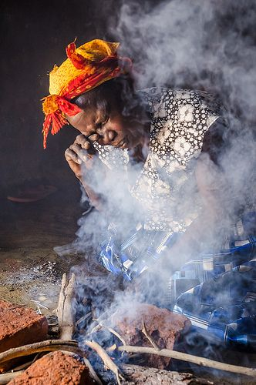
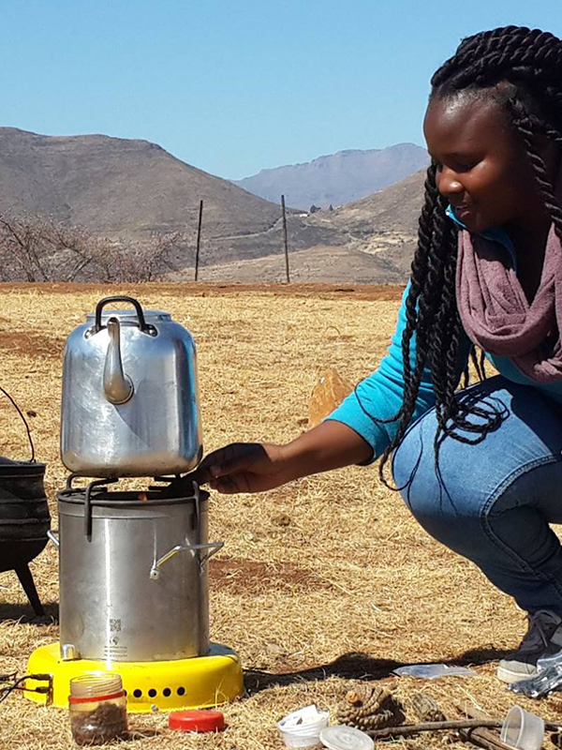
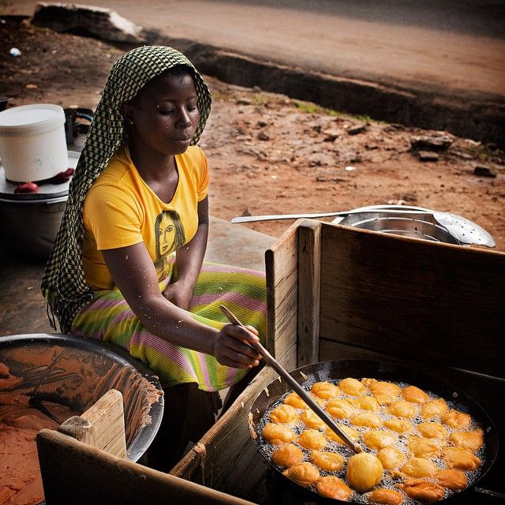
Frias Bio
Energy
……clean cooking for all

Slide 2
PROBLEM
About up to 4 million people die prematurely each year due to indoor air pollution caused by exposure to open fires and inefficient cook-stoves. While burning solid fuels such as wood, charcoal and tree leaves.
Nearly 3 billion people still rely on open fires or inefficient cook-stoves to cook their meals; 85% of whom are concentrated in 20 high impact countries. Women and children are disproportionately impacted as they spend the most times near the cooking areas
Source: IRENA

Slide 3
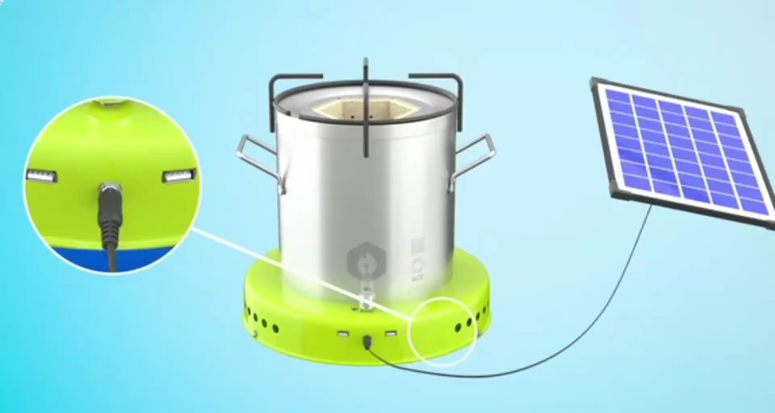
SOLUTION & TECHNOLOGY
Our solution which is a solar-biomass hybrid cook stove is to provide a clean, smokeless cooking experience for its users. The solar-powered electricity it generates can also be used for phone charging and lighting.
Working Principle:
Ventilator blows oxygen into the top and bottom of the burning chamber
Oxygen causes temperature of the fire within the chamber to increase to approximately 1000C, at this point biomass will gasify
Hot gas floats to the top of the burning chamber where it meets more oxygen and combusts completely

Slide 4
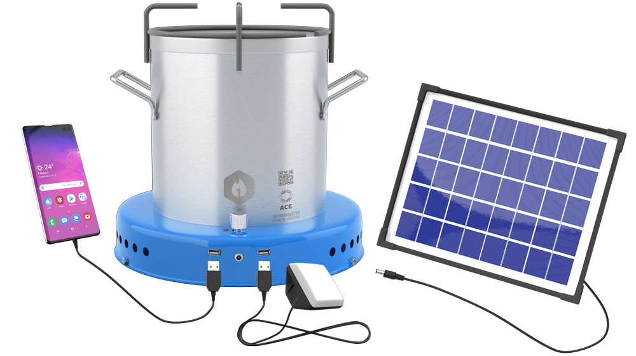

Value Proposition
Orion Pro 1 Stove
Mobile
Phone
Combustion Chamber
Multi-fuel system which reduces fuel needs
Orion
Pro-1 Stove
Accessible on flexible micro-loan (pay as you save model)
Significant amount of fuel & household savings
Ecofriendly, reliable and increased lifespan
Charging port
Lamp

Slide 5
Market Size
$900
$500
$100
MILLION
MILLION
MILLION
Total Addressable Market(TAM)
Segmented Addressable Market (SAM)
Share Of Market (SOM)
Entire Nigeria Market
North Western Region Of Nigeria
Beach Head Market In Kano
Source: REAN

Slide 6
Business Model
Key
Partners
Key
Activities
Value
Proposition
Customer
Relationships
Customer
Segments
1.Research Institutions 2. Distributors 3. Clean Cooking Alliance 4.Brand Ambassadors
1. Product design 2. Product installation 3. Educate on the need for clean and reduced emissions cook stoves 4. Research and development
1 Access to affordable electricity 2 Access on flexible micro loan (Pay As You Save Model) 3.Multi-fuel system which reduces fuel needs 4 Increased life span
1. Our distributors 2. Online feedback. 3. Campaigns and promo. 4. Helpdesk and Customer Support management. 5. Sales and B2B engagement.
Individuals or household that lack access to; 1. Clean Cooking System. 2. Affordable Energy 3 . Light Orion Pro 1 connect App gives room for customer feedback
Key
Resources
Channels
5 Improved cooking efficiency
1. Social media 2. Company Website 3. Village display 4. Partner store 5. Promotion/advertisement 6. Strategic Business development
1. Workshop ∙ Marketer ∙ Grant writer ∙ Lawyer Skill workforce
Energy Consultant
Cost Structure
Revenue Streams
1. Factory 2. Logistics and supply 3. Marketing/advertisement 4. Equipment 5. Employees
We will generate our revenue by selling; Our products directly; Orion Pro1 Cook stove; Pellet Sales; Carbon Credits Sales; Also by Franchising
6. Research and Development

Slide 7
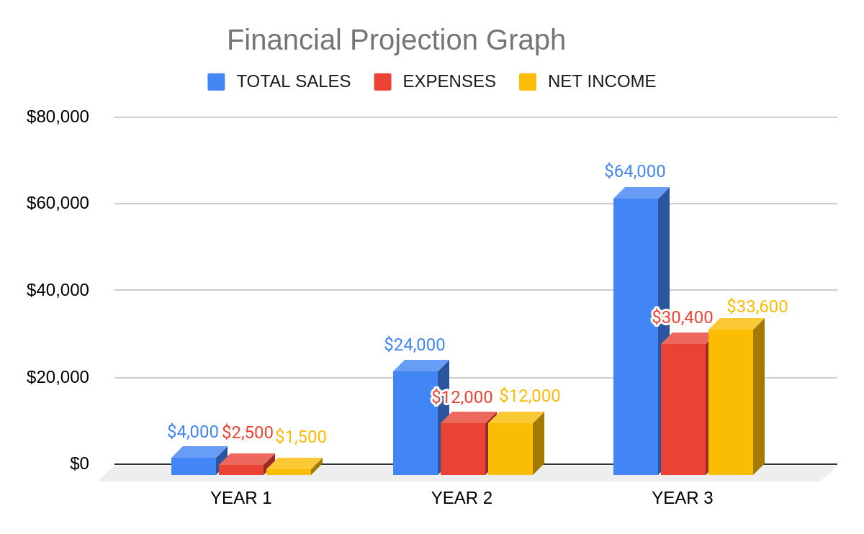
FINANCIALS

Slide 8







IMPACT
Health
25,000 ICS Stoves will avert 40 deaths and add 1295 years of healthy life as a result of reduced cook-smoke exposure according to the University of Berkeley.
Environment
It will reduce deforestation and pressure on fragile ecosystems
10+ Million tons of CO2 emission reduction in the next five years
Economic
It will give people living on a $2 a day access to a $80+ product

Slide 9


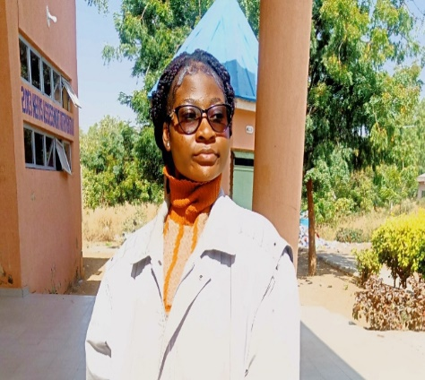
Our Team
Fortune Riagbayire
Founder/CEO
Clean Energy Advocate
Ebere Mercy
CFO
Climate Finance Analyst
Favour Ogbomola
COO

